Slide 1
Axial T2-weighted MRI of the brain

Slide 2
Axial T2-weighted MRI of the brain
Answer: Fourth ventricle
• The fourth ventricle is a diamond-shaped structure that lies posterior to the pons.
• It is connected to the third ventricle superiorly via the aqueduct of Sylvius and to the central canal of the
spinal cord inferiorly.
• It is also connected to the basal cisterns. One median aperture called the foramen of Magendie opens
into the cisterna magna, whilst two lateral apertures called the foramina of Luschka open out into the
cerebellopontine angle cisterns.

Slide 3
Sagittal CT of the brain

Slide 4
Sagittal CT of the brain
Answer: Clivus
• Clivus is Latin for ‘slope’.
• It slopes obliquely in the midline.
• It lies posterior to the dorsum sellae and sphenoid sinus and anterior to the basilar artery and pons.
• It includes the posterior aspect of the body of the sphenoid bone and the basilar portion of the occipital
bone.

Slide 5
Axial T2-weighted MRI of the brain

Slide 6
Axial T2-weighted MRI of the brain
Answer: Basilar artery
• The basilar artery is a single vessel in the midline and is part of the posterior circulation.
• It lies posterior to the dorsum sellae and clivus and anterior to the pons.
• It arises from the paired vertebral arteries at the base of the pons.
• It gives off the following paired branches:
○ Anterior inferior cerebellar artery
○ Labyrinthine artery (variable)
○ Pontine artery
○ Superior cerebellar artery
• The basilar artery terminates at the paired posterior cerebral arteries.

Slide 7
Coronal T1-weighted MRI of the brain

Slide 8
Coronal T1-weighted MRI of the brain
Answer: Pituitary gland
• The pituitary gland is harder to recognise on coronal images given that you will be more used to looking
at it on sagittal views.
• There are several clues that will help you identify this structure.
○ It sits within a depression in the sphenoid sinus—this is the sella turcica.
○ There is a stalk arising from its superior aspect—this is the infundibulum.
○ It is a midline structure.
○ The optic chiasm is superior

Slide 9
Axial T2-weighted MRI of the brain

Slide 10
Axial T2-weighted MRI of the brain
Answer: Interpeduncular cistern
• This portion of the brainstem is the midbrain, which somewhat resembles the head of Mickey Mouse.
• Between the cerebral peduncles (which are the ears of Mickey Mouse) lies the interpeduncular fossa.
The interpeduncular cistern is located within the interpeduncular fossa.
• It lies posterior to the optic chiasm.

Slide 11
MR venogram

Slide 12
MR venogram
Answer: Inferior sagittal sinus
• The inferior sagittal sinus runs along the inferior border of the falx cerebri.
• It drains into the straight sinus, as does the great cerebral vein of Galen.
• It can be distinguished from the great vein by the fact that it parallels the course of the superior sagittal
sinus.
• The figure below shows the main dural venous sinuses.

Slide 13
Axial CT of the brain

Slide 14
Axial CT of the brain
Answer: Interhemispheric fissure
• An interhemispheric fissure is a deep groove running from anterior to posterior in the midline that
separates the left and right cerebral hemispheres.
• The falx cerebri runs through the fissure as shown in the image.

Slide 15
Axial CT of the brain

Slide 16
Axial CT of the brain
Answer: Third ventricle
• The third ventricle is a slitlike structure in the midline that is filled with cerebrospinal fluid.
• It is connected to the lateral ventricles by the foramina of Monro and to the fourth ventricle by the aqueduct
of Sylvius.
• The thalami sit on either side of the third ventricle.

Slide 17
Axial T2-weighted MRI of the brain

Slide 18
Axial T2-weighted MRI of the brain
Answer: Head of the left caudate nucleus
• The caudate nucleus lies lateral to the frontal horn of the lateral ventricle and medial to the internal
capsule.
• The caudate consists of the head, body, and tail (posterior).
• Putamen + caudate nucleus = striatum

Slide 19
Axial CT of the neck

Slide 20
Axial CT of the neck
Answer: Thyroid cartilage
• When viewed anteriorly, the thyroid cartilage is a shield-shaped structure that is composed of two flat
plates (laminae) that converge in the midline to form the laryngeal prominence.
• The epiglottis is attached to the inner surface of the thyroid cartilage at the midline.
• Extending from the posterior border of each lamina are superior and inferior horns to which numerous
muscles of the larynx attach.

Slide 21
Axial CT of the skull base

Slide 22
Axial CT of the skull base
Answer: Right styloid process
• The styloid process is a long and slender projection of the petrous temporal bone.
• It is the site of attachment of three muscles: the styloglossus, stylohyoid, and stylopharyngeus.
• On axial imaging, the styloid process appears as a small, rounded segment of bone between the ramus
of the mandible anteriorly and the mastoid air cells posteriorly.

Slide 23
Axial CT of the brain

Slide 24
Axial CT of the brain
Answer: Right thalamus
• The thalamus is a paired, walnut-shaped, deep grey matter multinuclear structure that lies on either
side of the third ventricle and anterior to the occipital horn of the lateral ventricles.
• It acts as a sensory and motor synaptic relay centre.

Slide 25
Axial CT of the brain

Slide 26
Axial CT of the brain
Answer: Left central sulcus of Rolando
• The central sulcus of Rolando is identifiable on an axial CT as the most crooked horizontal fissure resembling
an upside down omega (Ω).
• It separates the frontal lobe from the parietal lobe posteriorly.
• The precentral gyrus (anterior) is involved with motor control; the postcentral gyrus (posterior) is involved
with sensation.

Slide 27
Coronal MRI of the brain

Slide 28
Coronal MRI of the brain
Answer: Left Sylvian fissure (lateral sulcus)
• The Sylvian fissure is easily identifiable as the deepest and most prominent paired cortical sulcus.
• It separates the frontal and parietal lobes from the temporal lobe inferiorly.
• The Sylvian fissure is lateral to the insular gyrus.
• It contains the M1 and M2 segments of the middle cerebral artery.

Slide 29
MR venogram (MIP image)

Slide 30
MR venogram (MIP image)
Answer: Superior sagittal sinus
• The superior sagittal sinus is part of the venous drainage system of the brain.
• The superior sagittal sinus travels from anteriorly to posteriorly within the falx cerebri.
• It is a midline structure that drains into the confluence of the sinuses (torcular herophili) at the internal
occipital protuberance.
• It receives blood from both the superficial cerebral veins and the deep cerebral veins.

Slide 33
Axial CT of the head

Slide 34
Axial CT of the head
Answer: Right ramus of the mandible
• The ramus of the mandible is the posterior vertical extension of the body of the mandible.
• The superior mandibular ramus divides into the coronoid process (anteriorly) and the condyloid process
extending to the mandibular condyle (posteriorly).

Slide 35
Axial T2-weighted MRI of the brain

Slide 36
Axial T2-weighted MRI of the brain
Answer: Frontal horn of the right lateral ventricle
• The lateral ventricles are paired C-shaped structures.
• They consist of the frontal horn, body (central part), temporal (inferior) horn, and the occipital (posterior)
horn.
• They contain the choroid plexus, which produces the cerebrospinal fluid.

Slide 37
Axial T2-weighted MRI of the brain

Slide 38
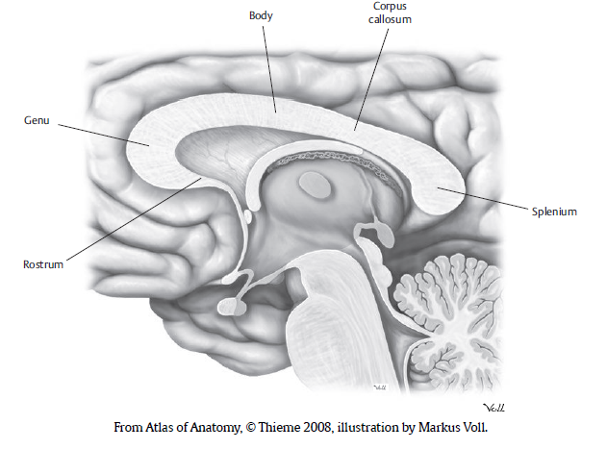
Axial T2-weighted MRI of the brain
Answer: Splenium of corpus callosum
• This is a midline structure that crosses the interhemispheric fissure and facilitates communication between
the left and right cerebral hemispheres.

Slide 39
Coronal MRI of the brain

Slide 40
Coronal MRI of the brain
Answer: Left temporal lobe (white matter)
• The temporal lobes are the most inferior lobes of the cerebral cortex.
• The temporal lobes occupy the middle cranial fossae.
• They are separated from the superior frontal lobes by the Sylvian (lateral) fissures (pictured).
• They contain the limbic system.

Slide 41
Radiograph of the face (occipitomental
30° projection)

Slide 42
Radiograph of the face (occipitomental
30° projection)
Answer: Right maxillary sinus
• The maxillary sinus, or antrum, is a pyramidal mucosa-lined air space in the body of the maxilla.
• It is inferior to the orbits and lateral to the nasal cavity.
• It is the largest of the paranasal sinuses.
• It drains into the middle meatus of the nose.

Slide 43
Axial T2-weighted MRI brain

Slide 44
Axial T2-weighted MRI brain
Answer: Midbrain
• The midbrain is the most superior portion of the brainstem.
• On axial images, it is ‘Mickey Mouse’–shaped; the cerebral peduncles resemble the ears.
• It connects to the thalamus (superiorly) and to the pons (inferiorly).
• The midbrain is divided into three portions:
○ Tectum (posterior)
• Made up of the tectal/quadrigeminal plate and the superior and inferior colliculi
○ Tegmentum
○ Cerebral peduncles (anterior)
• Separated by the interpeduncular fossa in the midline, which contains the mamillary bodies

Slide 45
Axial T2-weighted MRI of the brain

Slide 46
Axial T2-weighted MRI of the brain
Answer: Right mamillary body
• The mamillary body is a paired, small, round structure located in the interpeduncular cistern/fossa.
• It extends from the hypothalamus.
• It returns low signal on a T2-weighted MRI.

Slide 47
MR angiogram of the circle of Willis (MIP image)

Slide 48
MR angiogram of the circle of Willis (MIP image)
Answer: Left internal carotid artery
• The internal carotid arteries arise from the bifurcation of the common carotid arteries at the level of C4
and ascend to the base of the skull.
• They then enter the cranial cavity via the carotid canal in the petrous bone and follow a tortuous course
before terminating at the anterior perforated substance by dividing into the anterior and middle cerebral
arteries.
• At the circle of Willis, the internal carotid arteries can be recognised as the vessels with the greatest
diameters.

Slide 49
Coronal T2-weighted MRI of the brain

Slide 50
Coronal T2-weighted MRI of the brain
Answer: Left Meckel’s cave (trigeminal cave)
• Meckel’s cave is a pouch containing cerebrospinal fluid formed by two layers of dura mater derived from
the tentorium cerebelli.
• It contains the trigeminal nerve roots and ganglion.
• It lies adjacent to the posterolateral aspect of the cavernous sinus and lateral to the sphenoid bones.
• It is lateral to the internal carotid arteries.

Slide 51
Axial T2-weighted MRI of the brain

Slide 52
Axial T2-weighted MRI of the brain
Answer: Cerebellar vermis
• The cerebellar vermis is a single midline structure in the posterior fossa that connects the two cerebellar
hemispheres.
• It lies posterior to the fourth ventricle.
• The vermis is separated into nine lobules by fissures (folia).

Slide 53
Sagittal T1-weighted MRI of the brain

Slide 54
Sagittal T1-weighted MRI of the brain
Answer: Corpus callosum
• The corpus callosum is a midline C-shaped structure that is composed of a flat bundle of nerve fibres.

Slide 55
CT angiogram of the circle of Willis

Slide 56
CT angiogram of the circle of Willis
Answer: Left anterior cerebral artery (ACA)
• The circle of Willis is more pentagonal in shape than circular.
• It encloses the optic chiasm and pituitary stalk.
• The left and right ACA form the roof of the pentagon and are joined together by the anterior communicating
artery (which cannot be clearly visualised on the image).
• This is not the best example of the circle of Willis, but it has been included because the examples in the
examination are sometimes purposefully not of the best quality to test your knowledge.
• The figure below shows all the branches that form the circle of Willis.

Slide 57
Axial CT of the skull

Slide 58
Axial CT of the skull
Answer: Nasopharynx
• The pharynx is a muscular tube that is part of both the respiratory and gastrointestinal tracts.
• It is divided into three parts: the nasopharynx, oropharynx, and hypopharynx.
• On an axial image, the nasopharynx can be identified by its anterior communication with the nasal cavity.

Slide 59
Coronal MRI of the brain

Slide 60
Coronal MRI of the brain
Answer: Septum pellucidum
• The septum pellucidum is a thin, vertical membrane in the midline extending from the corpus callosum
to the fornix posteriorly.
• It separates the frontal horns of the left and right lateral ventricles.
• The septum pellucidum is situated anterior to the foramina of Monro.

Slide 61
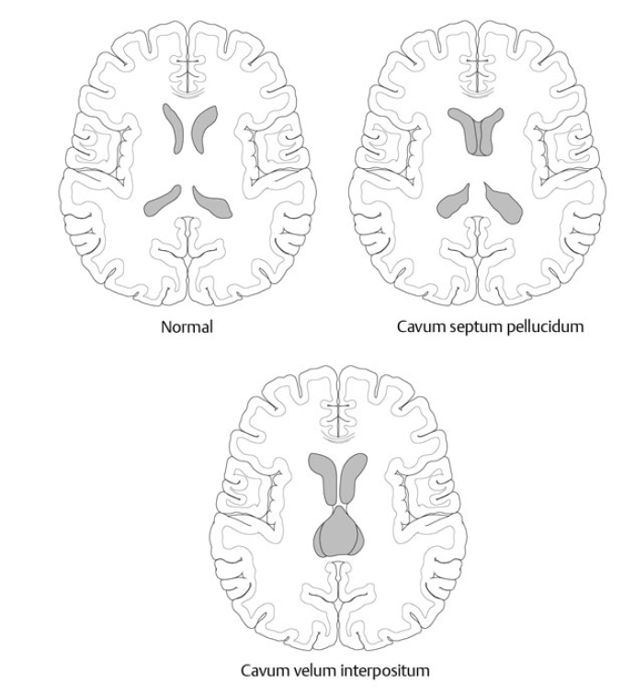
septum pellucidum
Normal variants:
○ Cavum septum pellucidum (anterior) and/or cavum septum vergae (posterior): Nonobliteration of
the potential space between the leaflets of the septum pellucidum
○ Cavum velum interpositum: Dilated CSF-filled space involving the velum interpositum, which extends
from the foramina of Monro to the quadrigeminal cistern

Slide 62
Sagittal T2-weighted MRI of the brain

Slide 63
Sagittal T2-weighted MRI of the brain
Answer: Quadrigeminal (tectal) plate
• The quadrigeminal plate is the dorsal portion of the midbrain.
• It is made up of the paired superior and inferior colliculi. It is responsible for visual and auditory
reflexes.
• The quadrigeminal plate is located within the quadrigeminal cistern.

Slide 64
MR angiogram

Slide 65
MR angiogram with MIP image of the circle of
Willis
Answer: Basilar artery
• It is vital to memorise the components that form the circle of Willis because it is a common examination
question.
• The basilar artery is an unpaired vessel that is formed by the union of the two vertebral arteries.
• It lies close to the midline in most people but can deviate to one side away from the dominant vertebral
artery.
• It terminates by dividing into the left and right posterior cerebral arteries.

Slide 66
Coronal FLAIR MRI of the brain

Slide 67
Coronal FLAIR MRI of the brain
Answer: Left cerebellar hemisphere
• The cerebellum is an infratentorial structure in the posterior fossa.
• It is separated by the median cerebellar vermis into the right and left cerebellar hemispheres.
• The cerebellar hemispheres are separated into lobules by fissures (folia).
• The cerebellum is connected to the brainstem via three cerebellar peduncles:
○ Superior peduncle connects to the midbrain
○ Middle peduncle connects to the pons
○ Inferior peduncle connects to the base of the pons

Slide 68
Sagittal T2-weighted MRI of the brain

Slide 69
Sagittal T2-weighted MRI of the brain
Answer: Cingulate gyrus
• The cingulate gyrus is a midline curved structure that lies inferior to the frontal lobes and superior to
the corpus callosum.
• It is separated from the corpus callosum by the cingulate sulcus.
• The cingulate gyrus forms part of the limbic system.

Slide 70
Coronal MRI of the brain

Slide 71
Coronal MRI of the brain
Answer: Aqueduct of Sylvius (cerebral aqueduct)
• The aqueduct of Sylvius is a thin, midline tube that connects the third ventricle to the fourth ventricle.
• It is located in the midbrain between the pons (anterior) and the cerebellum (posterior).
• It is filled with cerebrospinal fluid.

Slide 72
Sagittal T2-weighted MRI of the brain

Slide 73
Sagittal T2-weighted MRI of the brain
Answer: Cerebellar tonsil
• The cerebellar tonsil is the most inferior lobule of the cerebellar hemisphere.
• It lies posterior to the medulla.
• Its inferior tip lies above or at the level of the foramen magnum.

Slide 74
Axial T2-weighted MRI of the brain

Slide 75
Axial T2-weighted MRI of the brain
Answer: Cisterna magna
• The cisterna magna is a cerebrospinal fluid–filled arachnoid space in the posterior fossa.
• It is situated between the cerebellar hemispheres and posterior to the inferior aspect of the medulla.
• It is connected to the fourth ventricle via the foramina of Luschka and Magendie.

Slide 76
Axial T2-weighted MRI of the brain

Slide 77
Axial T2-weighted MRI of the brain
Answer: Genu of corpus callosum
• The genu is the anterior pole of the corpus callosum.
• Genu is Latin for ‘knee’. Notice its shape when viewed in the sagittal plane.

Slide 78
MR angiogram

Slide 79
MR angiogram of the circle of Willis (MIP image)
Answer: middle cerebral artery
• The middle cerebral artery (MCA) is the largest branch of the internal carotid artery.
• It does not actually form one of the sides of the pentagon that is the circle of Willis.
• Instead, it branches from the internal carotid artery and travels laterally into the insula toward the cortex
where it terminates.
• The MCA and its branches supply the basal ganglia, the anterior part of the internal capsule, the lateral
cerebral cortex, the anterior temporal lobe, and the insular cortex.
• The segment from the origin to the bifurcation/trifurcation is referred to as the M1 segment (as shown
in the image).

Slide 80
Axial T2-weighted MRI of the brain

Slide 81
Axial T2-weighted MRI of the brain
Answer: Right putamen
• The putamen lies lateral to the anterior limb of the internal capsule and anterolateral to the globus pallidus.
• Putamen + caudate nucleus = striatum
• Putamen + globus pallidus = lentiform nucleus

Slide 82
Axial T2-weighted MRI of the brain

Slide 83
Axial T2-weighted MRI of the brain
Answer: Anterior limb of the right internal capsule
• This is a white matter tract that separates the caudate (medially) from the lentiform nucleus (laterally).
• It returns a lower signal on T2-weighted imaging relative to the lentiform nucleus.

Slide 84
Sagittal T1-weighted MRI of the brain

Slide 85
Sagittal T1-weighted MRI of the brain
Answer: Anterior lobe of pituitary gland
• The pituitary gland is located in the sella turcica (Latin for ‘Turkish saddle’), inferior to the optic chiasm.
• It is connected to the hypothalamus via the infundibulum (stalk).
• It demonstrates strong contrast enhancement because it is not contained within the blood–brain
barrier.
• The posterior pituitary gland is bright on a T1-weighted (unenhanced) scan.

Slide 86
Coronal T1-weighted MRI of the brain

Slide 87
Coronal T1-weighted MRI of the brain
Answer: Optic chiasm
• The optic chiasm is located in the suprasellar cistern.
• It lies superior to the pituitary gland and anterior to the pituitary stalk (infundibulum).

Slide 88
Coronal CT of the brain

Slide 89
Coronal CT of the brain
Answer: Left inferior nasal turbinate bone
• The turbinates are respiratory epithelium-lined, curled bones in the lateral portion of the nasal cavity.
• They are divided by the nasal septum in the midline.
• There are three pairs of nasal turbinates:
○ Inferior turbinates (the largest)
○ Middle turbinates
○ Superior turbinates

Slide 90
Coronal MRI of the brain

Slide 91
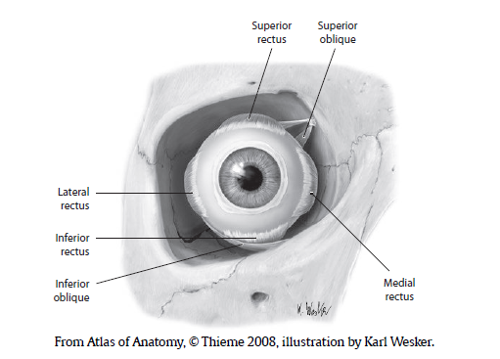
Coronal MRI of the brain
Answer: Right inferior rectus muscle
• The inferior rectus muscle is a paired structure that depresses the eye.
• It is innervated by the oculomotor nerve.
• It is one of the six extraocular muscles of the orbit. See figure below.

Slide 92
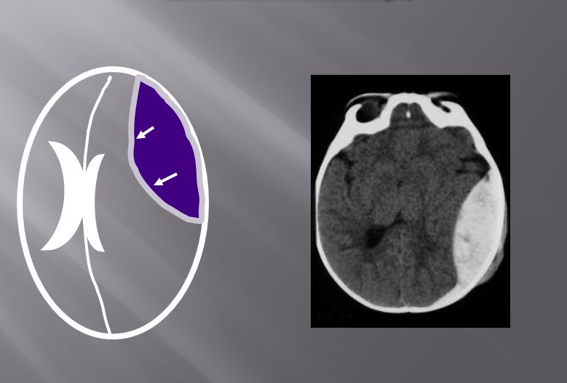

Slide 93
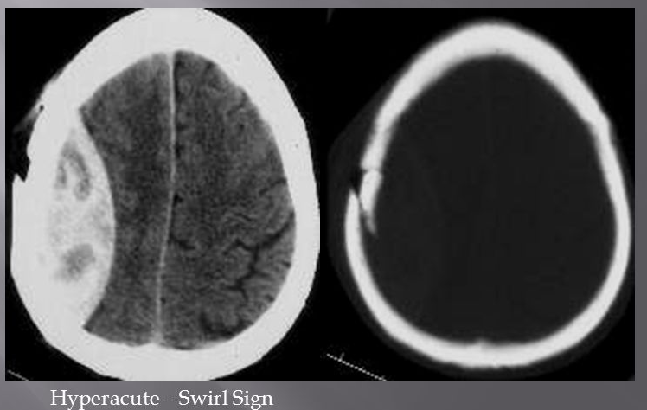

Slide 94
